Slide 1
Concept for UI
Barbs Dungeon Prototype

Slide 2
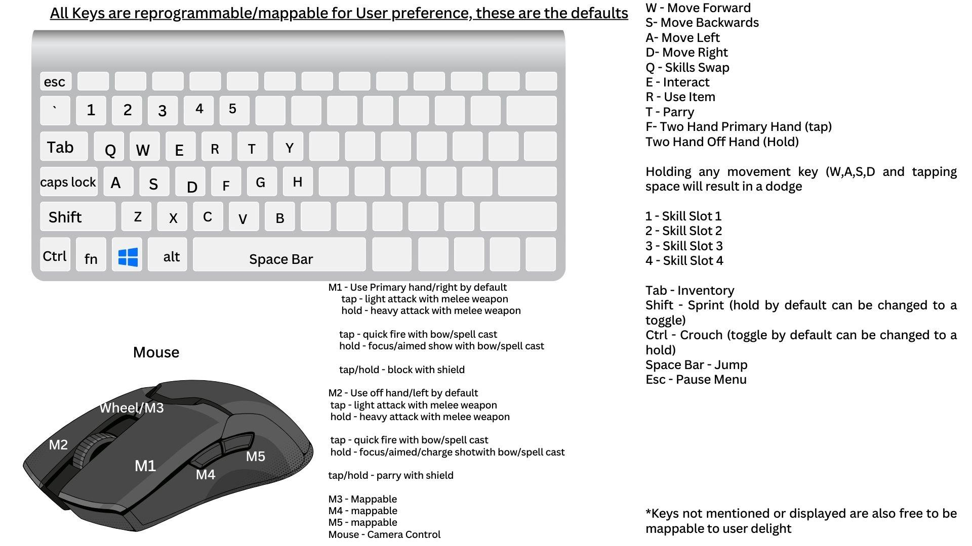
Keyboard Layout

Slide 3
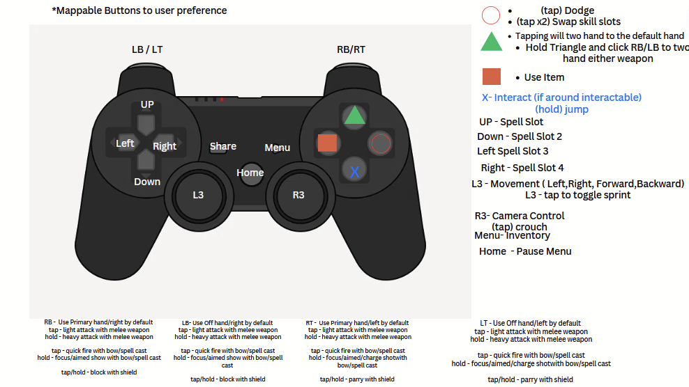
Controller Layout

Slide 4
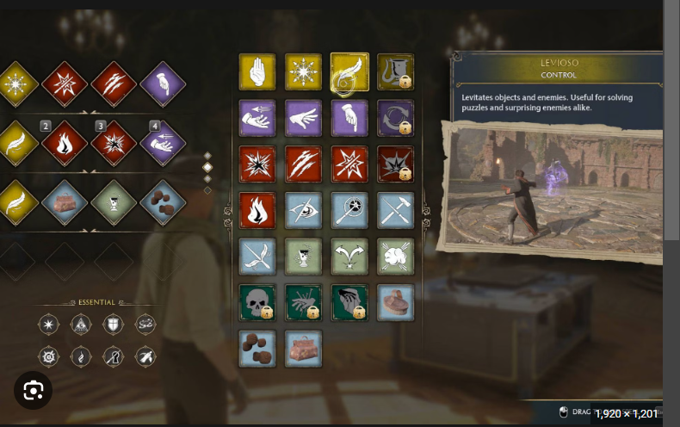
Spell Menu
Spell mapping
Switching out ‘Quick cast’ spells

Slide 5
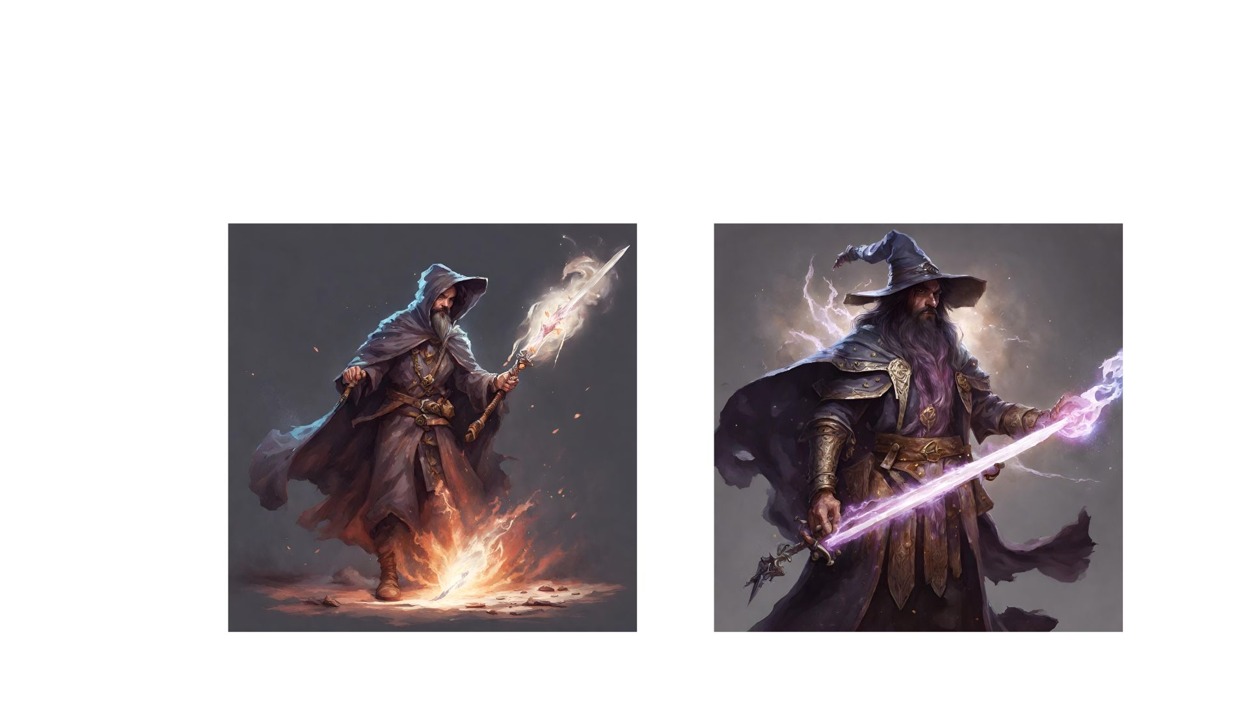
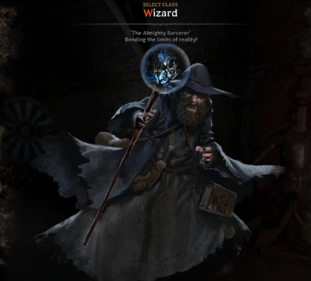
Wizard Concept Art
Wizard with conjured sword
Conjuration magic

Slide 6
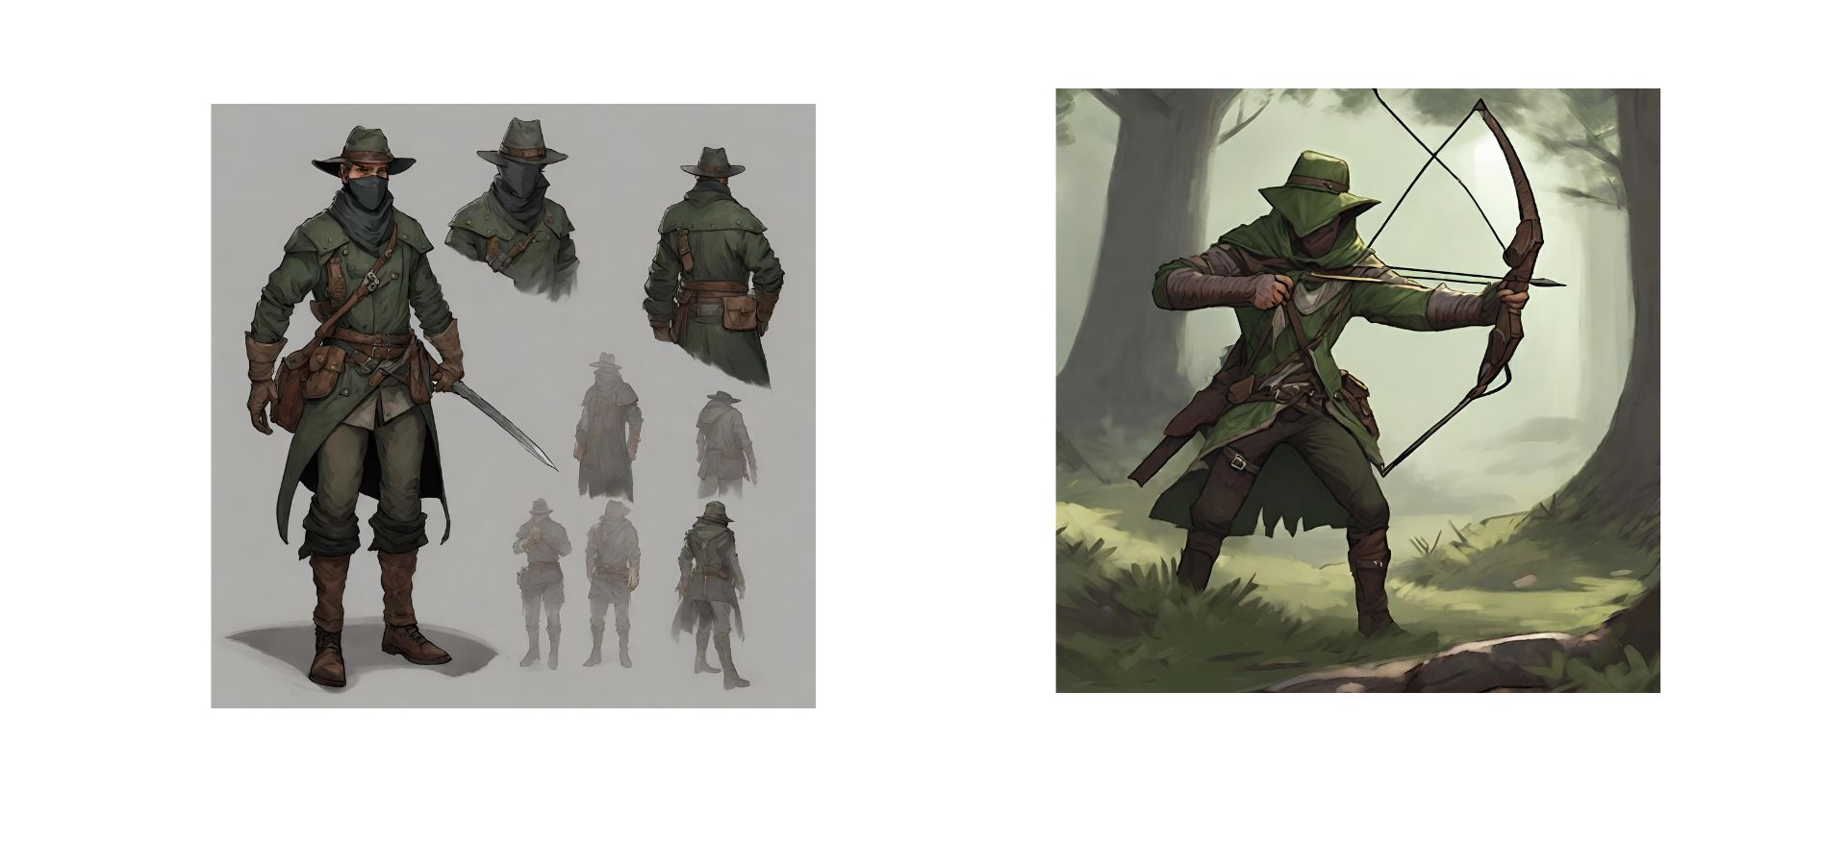
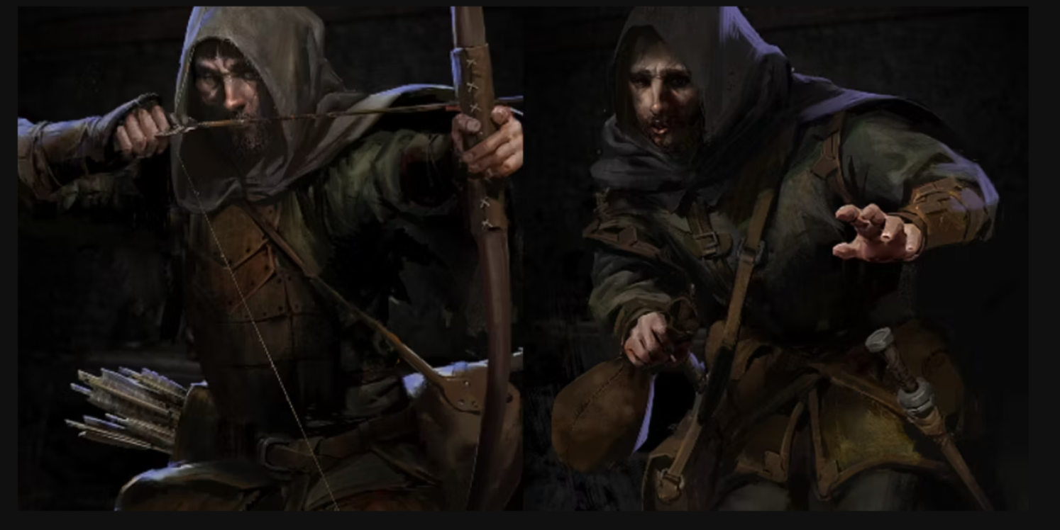
Ranger Concept Art
Ranger
Archery combat
Thievery combat

Slide 7
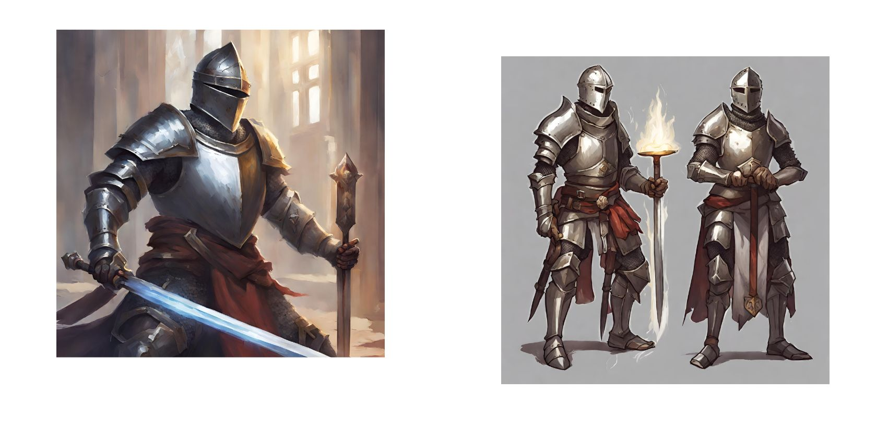
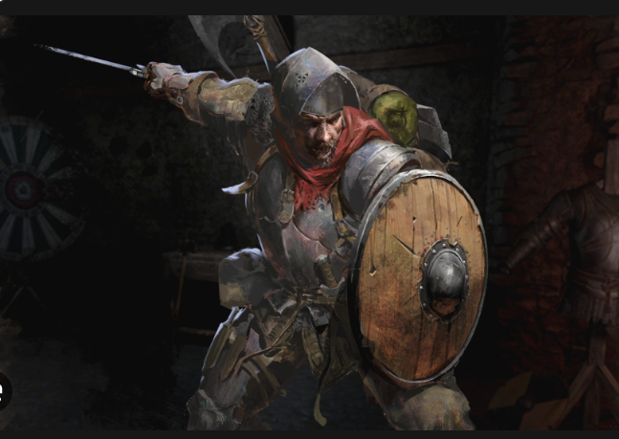
Knight Concept Art
Knight
Holy Knight playstyle
“Dumb tanky” knight playstyle

Slide 8
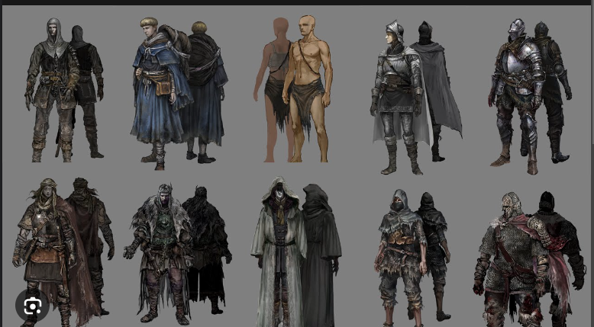
Concept Art for different armor sets/character designs

Slide 9
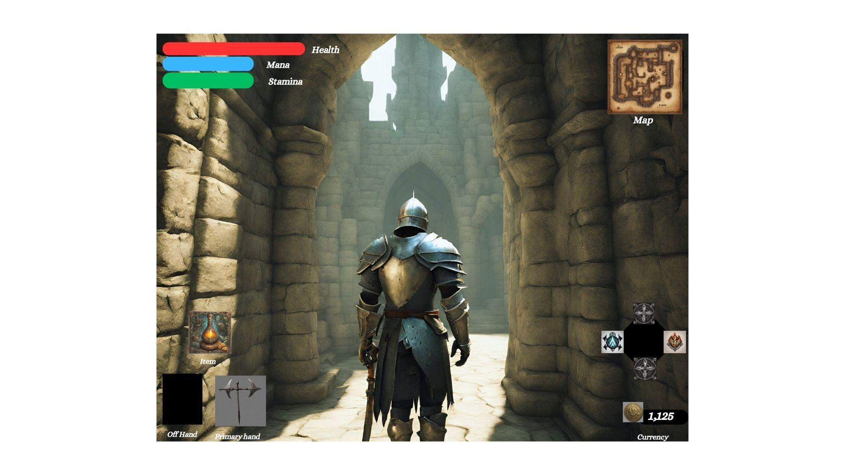

Slide 10
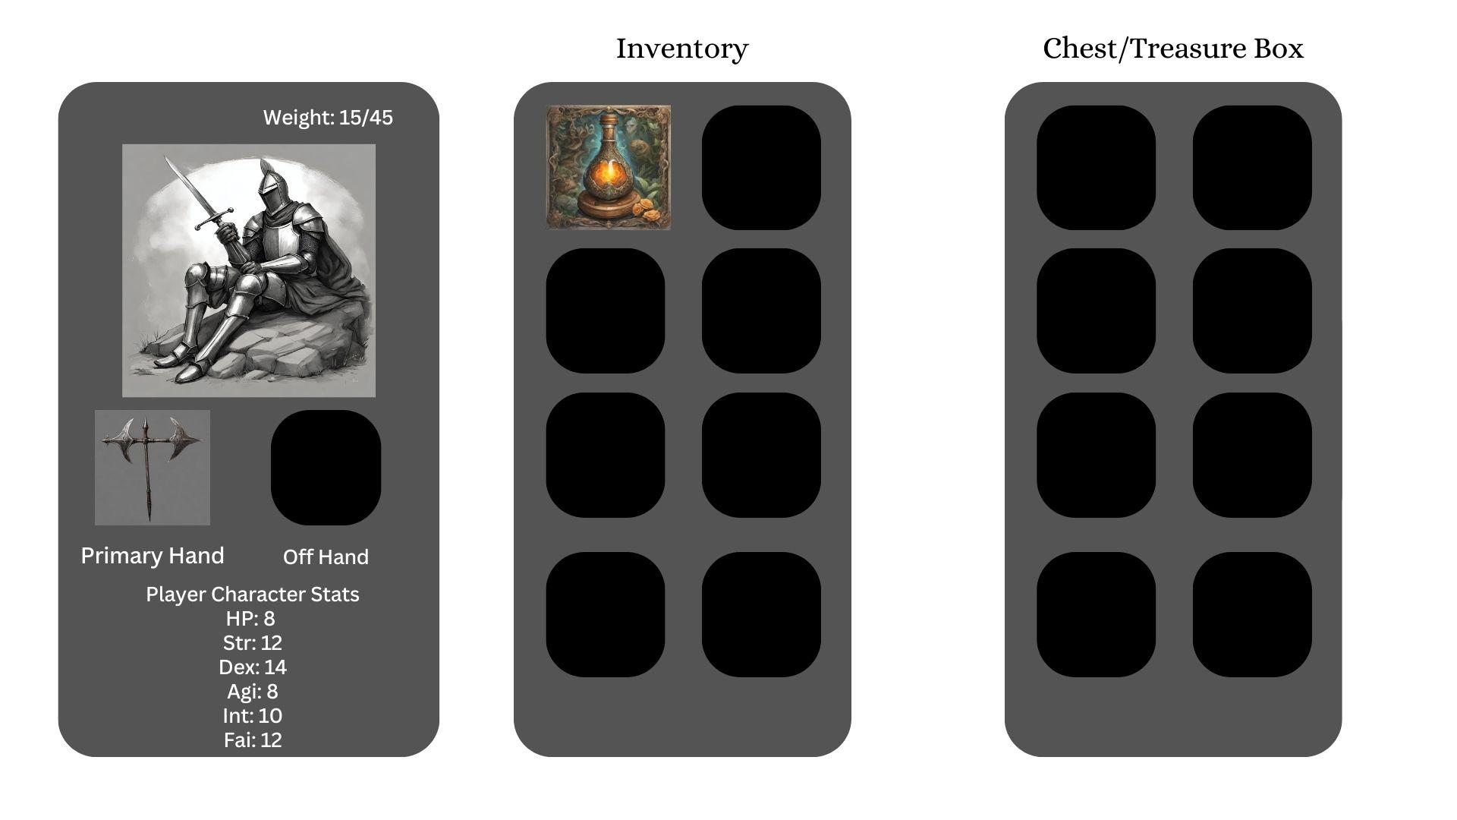

Slide 11
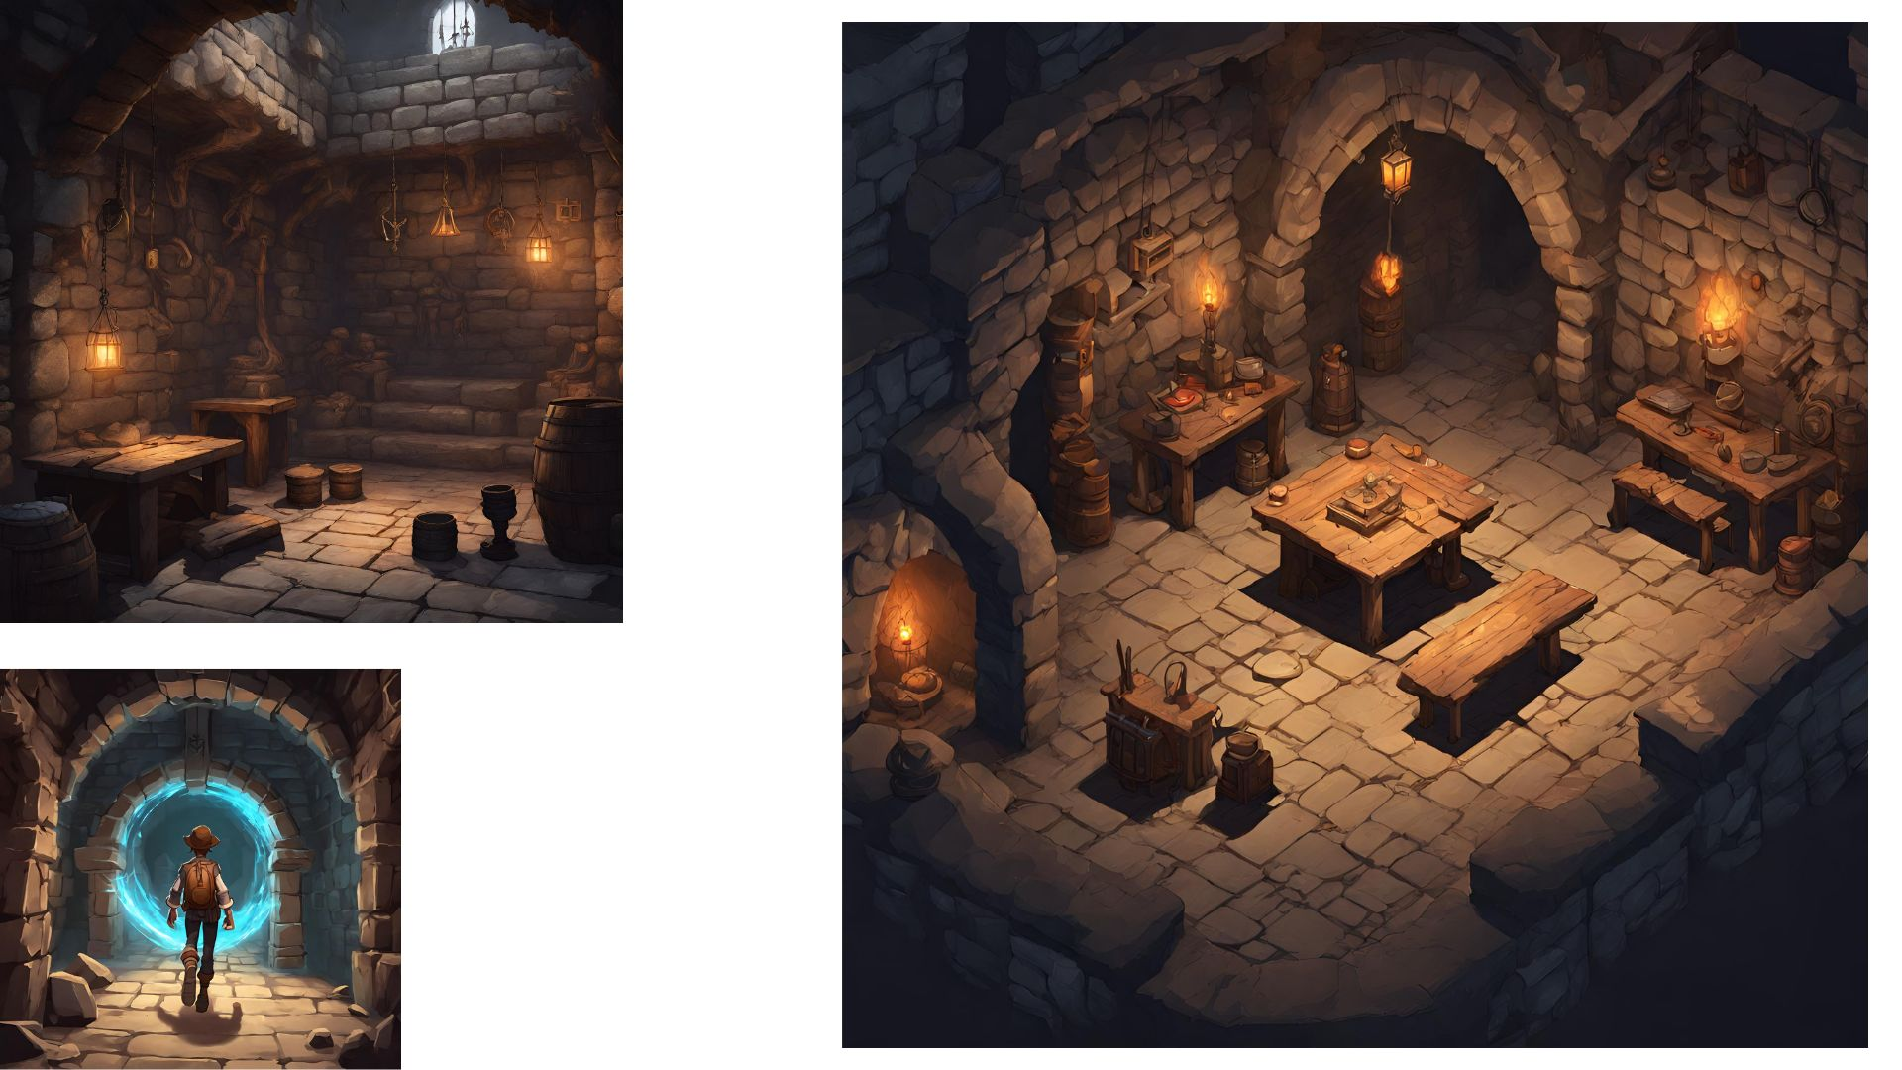
General safe room layout
Fast Travel system

Slide 12
Links
Canva Link: https://www.canva.com/design/DAFye_OCfiQ/szsDpTbm9U-hsbsxYrtaoQ/edit?utm_content=DAFye_OCfiQ&utm_campaign=designshare&utm_medium=link2&utm_source=sharebutton

